Slide 1
R User Group
Building a community of R users in Connecticut state government
January 14, 2025

Slide 2
Agenda
Happy new year! Review dates for 2025.
Github reminder
Demo: Using R Markdown to create reports in Word

Slide 3
2025 meeting schedule
Monthly meetings: second Tuesday of each month
January 14
February 11
March 11
April 8
May 13
June 10
July 8
August 12
September 9
October 14
November TBD
December 9

Slide 4
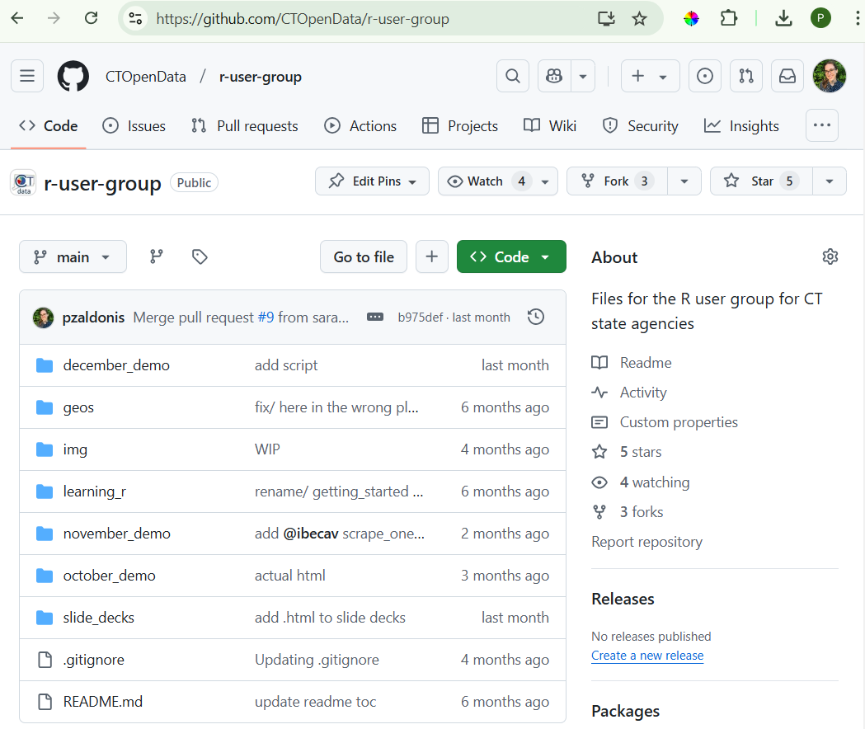
R User Group Github
We save the slides and demo scripts to our Github repository
Check out our repo here: https://github.com/CTOpenData/r-user-group
Don’t need an account to view the content

Slide 5
Demo: Making reports with R Markdown

Slide 6
What is R Markdown?
Combine Code and Text: R Markdown lets you write code, its results, and explanatory text all in one document.
Reproducible and Versatile:
Fully reproducible for transparency.
Export to various formats: Word, HTML, PDF, PowerPoint, and more.
Designed to create fully reproducible, dynamic reports and documents.

Slide 7
Use cases
I want to create a report that summarizes the results of a survey in a nice-looking Word document with charts and text.
I want to make reports for all agencies that show tables and charts summarizing their utility use and cost over time.

Slide 8
Use cases
I want to create a report that summarizes the results of a survey in a nice-looking Word document with charts and text.
We will demo this today!
I want to make reports for all agencies that show tables and charts summarizing their utility use and cost over time.
Example: Agency Sustainability Performance Plans / 2022 SPP for DOT

Slide 9
Creating an R Markdown file
New File: Open RStudio → File → New File → R Markdown.
File Format: Saved with a .Rmd extension (plain text).
Meet Quarto: An enhanced version of R Markdown with extended features.

Slide 10
Anatomy of an R Markdown file
YAML Header:
Defined by --- at the top and bottom.
Controls output format (e.g., HTML, PDF), style, and metadata.
Code Chunks:
R code enclosed by ```{r}``` and ``` ````.
Customize with options:
include = FALSE: Run the code without displaying it.
echo = FALSE: Show results but hide the code.
message = FALSE and warning = FALSE: Suppress messages or warnings.
fig.cap = "Caption": Add captions to figures.
Text Formatting:
Headings: # Heading.
Italics: _italic text_.

Slide 11
Running and compiling your document
Run Chunks Individually:
Click the green arrow next to each chunk to execute code.
Knitting the Document:
Click the “Knit” button to:
Run all chunks.
Generate a final output file (Word, HTML, PDF, etc.).
Behind the scenes: Sends your .Rmd file to knitr to process.

Slide 12
Demo materials
R Script: state_data_plan_survey.Rmd
Survey data: survey_results.csv
Word doc style template: state_data_plan_survey_template.docx – Word doc with desired styling for output Word file

Slide 13
R Markdown resources
R for Data Science - R Markdown Chapter
R Markdown Cheatsheet

